Slide 1
Introduction to D.A.S.H
By Yifan Ge

Slide 2
Agenda
Background Information
Key Features
Kinematic Diagram & Demo

Slide 3
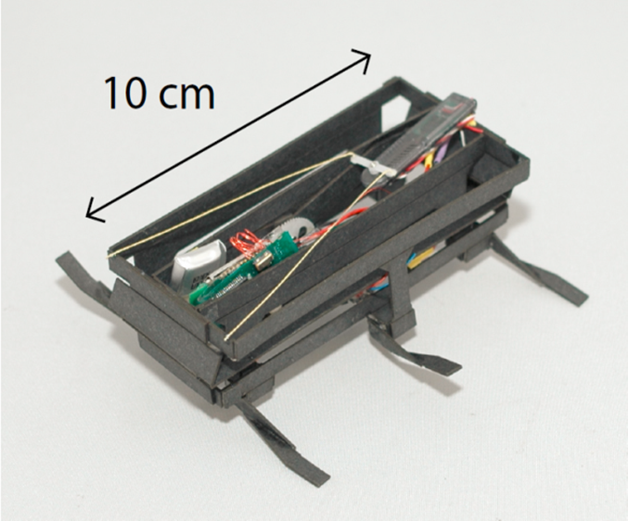
Background
Dynamic Autonomous Sprawled Hexapod
Developed by University of California
Goal:
Small & High Mobility
High Power densities and efficiency
Easy and cheap to build
Notes:
Small & Mobility:
Benefit: easily transported, reach inaccessible areas
Drawback: less space for multiple actuators, batteries
Requires:
High power densities and efficiency:
Passive mechanism elements from Biology: Preflexes (tendons [faster than neurological response]), Sprawled alternating tripod gait (Imparts stability).
Human running
Easy and cheap:
Fast to deploy and no hurt if destroyed

Slide 4
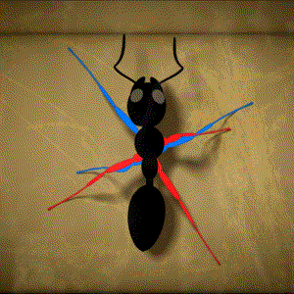
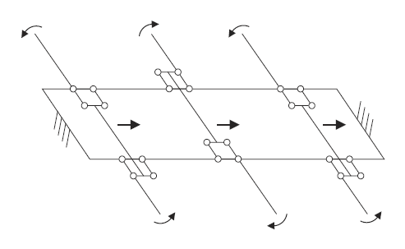
Key Features
Sprawled alternating tripod gait
1.5 m/s
Oar mechanism
Differential Drive
SCM Process
Steering Design
Notes:
Differential drive:
Has a floating ground, where only the relative motion of the bottom and the top of the robot achieve useful output at the legs
iSprawl and Mini-Whegs: the entire drive train is grounded to the same structure to which the hips are attached
SCM:
Smart Composite Manufacturing
Flexibility, high surface-to-weight ratio

Slide 5
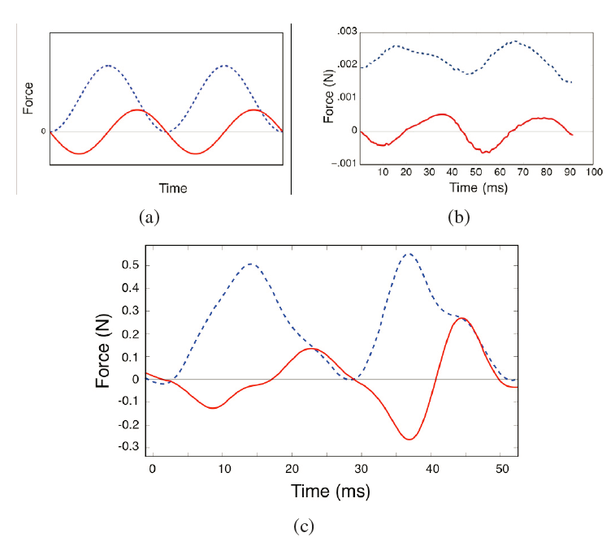
SLIP Model
Notes:
SLIP: Spring-loaded inverted pendulum
Red: fore-aft forces. Blue: normal forces
A: SLIP model
B: ground reaction forces of a cockroach
C: DASH

Slide 6
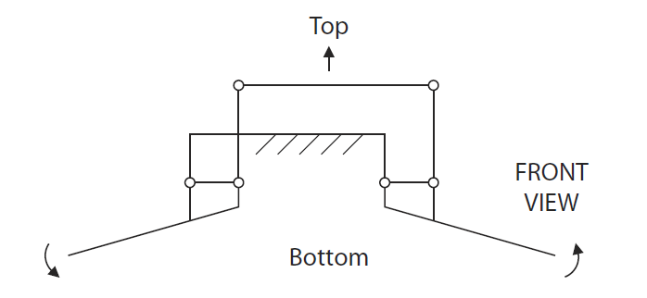
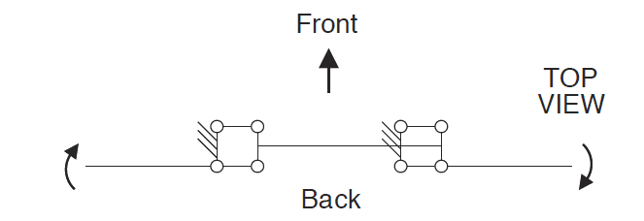
Kinematic Diagram
Notes:
Paradoxes to Gruebler’s Equation or Kutzbach’s Equation.

Slide 7
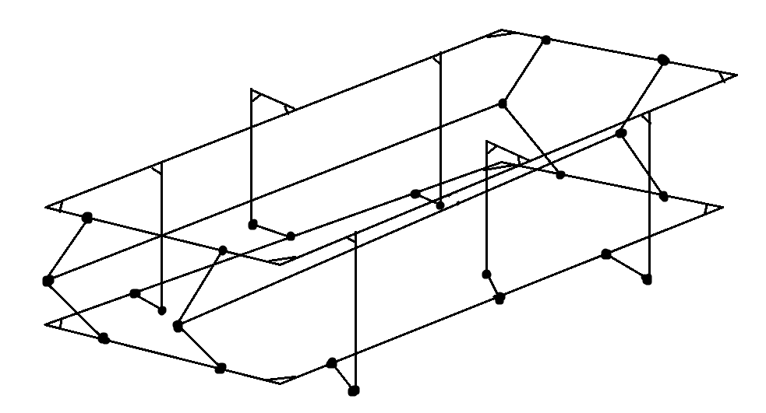
3-Dimensional Kinematic Diagram

Slide 8
Demo
With Lego

Slide 9
Questions?

Slide 10
References
P. Birkmeyer, K. Peterson, and R. S. Fearing, “DASH: A Dynamic 16g Hexapedal Robot,” IEEE Int. Conf. Intelligent Robots and System, St. Louis, MO Oct. 2009

